Slide 1
Akila Place
Manh

Slide 2
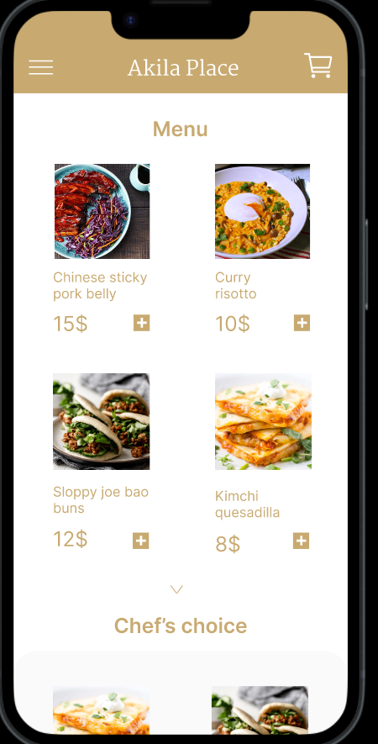
Project overview
The product:
Akila Place is a food ordering application designed to allow users to place orders and receive information from the Akila Place restaurant
Preview of selected polished designs.
Project duration:
4/2023 – 5/2023

Slide 3
Project overview
The problem:
People are interested in the restaurant but it seems that information about it on the internet is not so much.
The goal:
The goal of the Akila Place application is to provide a user-friendly platform for customers to order food and receive information from the Akila Place restaurant.

Slide 4
Project overview
My role:
Lead UX/UI designer
Responsibilities:
user research, wireframing, prototyping, designing

Slide 5
User research
Personas
Problem statements
User journey maps
Understanding
the user

Slide 6
User research: summary
User research was conducted to understand the needs and preferences of customers of Akila Place restaurant for a new food ordering application. Surveys were sent out to a sample of customers to gather information on their ordering habits, preferred features for a food ordering app, and feedback on the restaurant's current ordering system. Based on the results, the Akila Place application was designed to include a user-friendly interface, customizable order options, and real-time delivery tracking. The user research helped ensure that the application met the needs and expectations of the restaurant's target customers.

Slide 7
User research: pain points
1
2
3
4
Navigate
Limitations
Service
Clearness
Difficulty navigating the restaurant's menu and finding specific dishes or ingredients
Limited customization options for orders, such as the ability to modify ingredients or dietary restrictions
Inconsistent or slow service that leads to long wait times for food
Lack of transparency around pricing and fees, such as delivery charges or taxes

Slide 8
Thank you!

